Slide 1

Resume Screening
Anuja Prakash Kolse
Alexander Wilcox
Oum Parikh

Slide 2
Contents
Introduction
Procedure
Dataset
Preprocessing
Vectorization
Modeling
Discussion
Conclusion

Slide 3
Introduction
Our initiative aims to build on the way resumes are assessed by incorporating cutting-edge unsupervised NLP tools. By automating the comparison of resumes against various job descriptions and model resumes, we calculate similarity scores to streamline the candidate selection process. This not only saves time but also helps reduce the unconscious bias often present in manual screening.

Slide 4
Introduction
We explored a range of vectorization techniques to convert textual resume data into numerical form, enabling us to harness these numerical embeddings to train an advanced categorization model. Our project's success lies in the novel calculation of similarity scores and in crafting a classifier that accurately categorizes resumes by profession. We utilized leading technologies such as Word2Vec, TF-IDF, and GloVe to achieve these results.

Slide 5
Procedure
Data preprocessing
Similarity score calculation
Classification analysis
Step 1
Step 3
Step 5
Step 2
Step 4
Vectorization technique
Modeling

Slide 6
Dataset
We used two datasets for our analysis, both containing industry-labeled resumes:
https://www.kaggle.com/datasets/gauravduttakiit/resume-dataset/data
https://www.kaggle.com/datasets/maitrip/resumes
Both resume datasets contain a total of 25 unique industry labels, encompassing a broad category description for resumes.

Slide 7
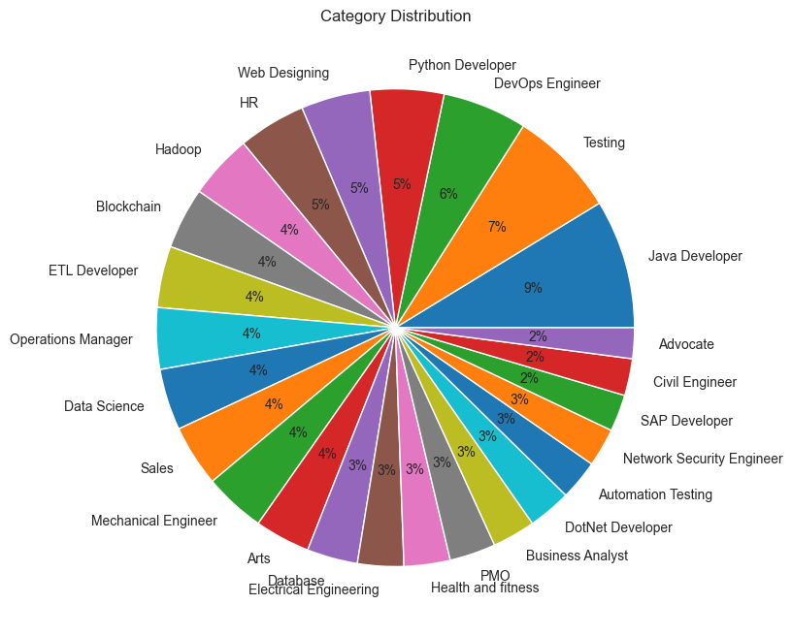
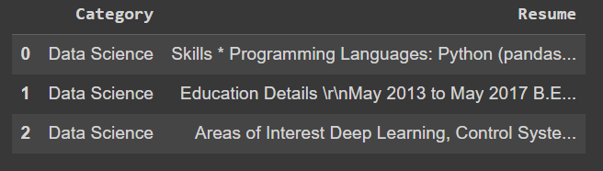
Dataset #1
Contains 962 total resumes.

Slide 8
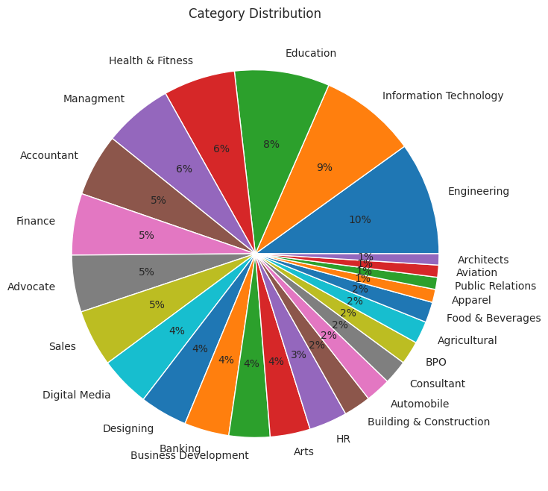
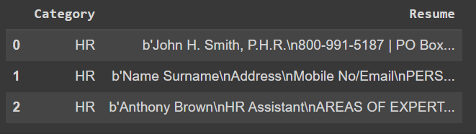
Dataset #2
Contains 1,219 total resumes.

Slide 9
Preprocessing
Lowercasing: Converts all characters in the text to lowercase. This is done to ensure that the same word in different cases (e.g., “Word” and “word”) is treated as the same word.
Removing Punctuation: Removes all punctuation marks from the text using a regular expression.
Tokenization: Tokenization splits the text into individual words or tokens. Here, we used nltk.tokenize.word_tokenize.

Slide 10
Preprocessing
Removing Stopwords: Filters out common words that are considered “stopwords” (e.g., “the,” “is,” “and,” etc.). We identified stopwords using nltk.corpus.stopwords.
Lemmatization: Reduces words to their base or root form (e.g., “running” → “run,” “better” → “good”, etc.). To lemmatize the raw resume texts, we used nltk.stem.WordNetLemmatizer.
Joining Tokens Back: After processing, the tokens are joined back together into a single string, separated by spaces.

Slide 11


Vectorization: TF-IDF
TF-IDF consists of two components:
Term Frequency (TF)
Inverse Document Frequency (IDF)
Formula:
TF-IDF = TF × IDF

Slide 12
Vectorization: Word2Vec
Word2Vec has two variants:
Continuous Bag of Words (CBOW): Predicts a target words based on surrounding context words.
Skip-Gram: Predicts surrounding context words from a target word.
Creates word embeddings by training on a corpus, leveraging the contexts in which words appear to learn their meanings.
Our initial experiments indicated the Skip-Gram model performed more effectively, and prompted us to adopt this approach for further analysis.

Slide 13
Vectorization: GloVe
GloVe - Global Vectors for Word Representation
Unsupervised learning algorithm developed to generate word embeddings by aggregating global word-word co-occurrence statistics from a corpus
Shallow, two-layer neural networks that are trained to reconstruct linguistic contexts of words

Slide 14
Vectorization
01
TF-IDF
sublinear_tf = False
max_features = 500
02
Word2Vec (Skip-Gram)
vector_size = 50
window = 3
03
GloVe
glove-wiki-gigaword-300

Slide 15
Modeling
OneVsRestClassifier: A multi-class strategy that fits one classifier per class and predicts the class with the highest probability.
Multi-Layer Perceptron (MLP): A type of neural network that consists of multiple layers of neurons, each connected to the next with weighted edges.
Support Vector Machine (SVM): A powerful algorithm that finds the optimal hyperplane that separates different classes in the feature space.

Slide 16
Results
Our thorough examination of two distinct datasets revealed considerable variations in model behavior and embedding efficacy, highlighting the complexity inherent in the resume screening process.
The results are for the two datasets with different Machine Learning algorithms are as shown in the subsequent slides.

Slide 17
Dataset #1, Comparison of Model-Embedding Pair Performance
Model | Embedding | Training Accuracy | Validation Accuracy
One-vs-Rest | TF-IDF | 97.9% | 97.5%
One-vs-Rest | Word2Vec | 96.9% | 94.0%
One-vs-Rest | GloVe | 97.4% | 94.5%
MLP | TF-IDF | 100% | 99.7%
MLP | Word2Vec | 80.5% | 84.1%
MLP | GloVe | 98.7% | 99.4%
SVM | TF-IDF | 99.9% | 99.5%
SVM | Word2Vec | 95.5% | 92.7%
SVM | GloVe | 99.7% | 98.8%

Slide 18
Dataset #2, Comparison of Model-Embedding Pair Performance
Model | Embedding | Training Accuracy | Validation Accuracy
One-vs-Rest | TF-IDF | 59.0% | 37.4%
One-vs-Rest | Word2Vec | 62.6% | 45.0%
One-vs-Rest | GloVe | 66.9% | 54.8%
MLP | TF-IDF | 94.0% | 64.4%
MLP | Word2Vec | 51.0% | 49.2%
MLP | GloVe | 79.4% | 66.0%
SVM | TF-IDF | 73.1% | 55.2%
SVM | Word2Vec | 43.8% | 40.7%
SVM | GloVe | 77.1% | 63.9%

Slide 19
Discussion
Different accuracy rates between two datasets raise key issues:
Dataset quality significantly affects model performance, especially with diverse resume formats during real-world deployment.
TF-IDF and GloVe always demonstrate superior performance over Word2Vec.
Models must generalize well across various data types to ensure consistent performance, despite potential information loss from further standardization in preprocessing.

Slide 20
Conclusion
While specific job descriptions revealed a superiority of one embedding technique over others in terms of similarity scores, the general performance of the classifiers remained consistent across the board within datasets. This observation underscores the resilience and effectiveness of the models, which demonstrated consistent accuracy rates on both the training and validation datasets.

Slide 21
DEMO

